Slide 1

Minor Project on Stock Market Analysis and Forecasting
Submitted by: Submitted to:
Anish Acharya [21075396] Department of Computer and IT Engineering
Bhuwan Prasad Joshi [21075406] Everest Engineering College
Chetan Babu Bhat [21075409] Affiliated to Pokhara University
Pradeept Jarur Shahi [21075421] Sanepa-2, Lalitpur.
25/09/2024

Slide 2
Contents
Introduction
Statement of problem
Objective
Literature Review
Methodology
Project Schedule and Budget
Expected Outcomes
Evaluation/Testing
References

Slide 3
Introduction/Background
Large Public Participation in Stock Market
Fundamental and Technical Analysis
Automated Analysis & Machine Learning
Market Forecasting and Profitability

Slide 4
Statement of Problem
Loss in the Stock Market
Technical Analysis and Fundamental Analysis
Time Consuming

Slide 5
Objectives
Develop a Predictive Model
Analyse Stock Market Trends
Improve Forecasting Accuracy
Notes:
Simplify hiring: Quickly identify suitable candidates.
Rank resumes: Highlight resumes that best match the job requirements

Slide 6
Literature Review
1)Deep Learning for Finance: Deep Portfolios
Author: J.B. Heaton
Objective: Automate the resume screening and matching process.
Final findings: In particular, deep learning can detect and exploit interactions in the data that are, at least currently, invisible to any existing financial economic theory.
Citation: https://scholar.google.com/scholar_lookup?title=Deep%20learning%20for%20finance%3A%20deep%20portfolios&publication_year=2017&author=J.B.%20Heaton&author=N.G.%20Polson&author=J.H.%20Witte

Slide 7
2) ARIMA Model for Forecasting Stock Prices
Author: Mondale
Objective: accounts for both autocorrelation and moving average elements within time series data
Final Findings: Results obtained revealed that the ARIMA model has a strong potential for short-term prediction and can compete favourably with existing techniques for stock price prediction.
Citation: http://dx.doi.org/10.5121/ijcsea.2014.4202

Slide 8
3)The Performance of LSTM and BiLSTM in Forecasting Time Series
Author: Sima Siami-Namini
Objective: Automate the process of filtering resumes.
Final Findings: it was observed that BiLSTM models provide better predictions compared to ARIMA and LSTM models
Citation: https://doi.org/10.1109/BigData47090.2019.9005997

Slide 9
4) NSE Stock Market Prediction Using Deep-Learning Models
Author: Hiransha
Objective: Determine a candidate’s qualification .
Final Findings: The results obtained were compared with ARIMA model and it has been observed that the neural networks are outperforming the existing linear model (ARIMA).
Citation: https://doi.org/10.1016/j.procs.2018.05.050

Slide 10
5. Stock Price Prediction Using Machine Learning and LSTM-Based
Deep Learning Models
Author: S.Mehtab
Objective: analyze historical price data and past events to potentially predict future trends, considering long-term factors that might influence the price
Final Findings: It has presented several approaches to prediction of stock index values its movement patterns on a weekly forecast horizon using eight machine learning, and four LSTM-based deep learning regression models
Citation:http://dx.doi.org/10.36227/techrxiv.15103602

Slide 11
Hardware and Software Required
Hardware Requirements: (a) Computer with Intel 3 or higher
processor with at least 4GB of RAM and 128GB of SSD.
Software Requirements:
(1) Google Colab
(2) Python
Tools required to do this project:
(1) TensorFlow:
(2) Matplotlib
(3) NumPy
(4) Pandas

Slide 12
Algorithm
Long Short-Term Memory (LSTM) algorithm is used in this project for
predicting stock prices. Long Short-Term Memory (LSTM) networks are often
considered better for stock market prediction
Ability to capture large sequential data and can learn long-term
dependencies.
It can handle Non-Linear and complex Patterns in the chart or prices
It is more suited for time series data
It has ability to learn from noise and volatility, since stock prices are
often noisy and volatile

Slide 13
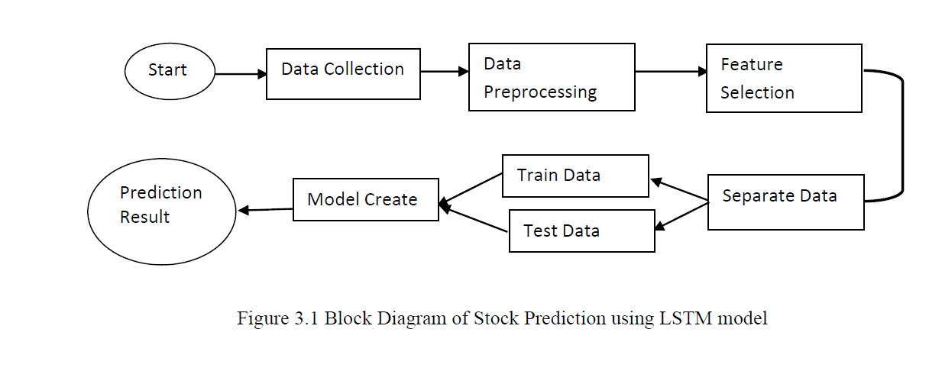
Methodology

Slide 14
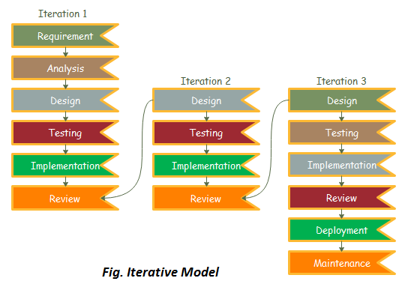
System Development Life Cycle
Iterative Model
Why?
Phased Approach
Feedback Loops
Risk Management
Flexibility

Slide 15
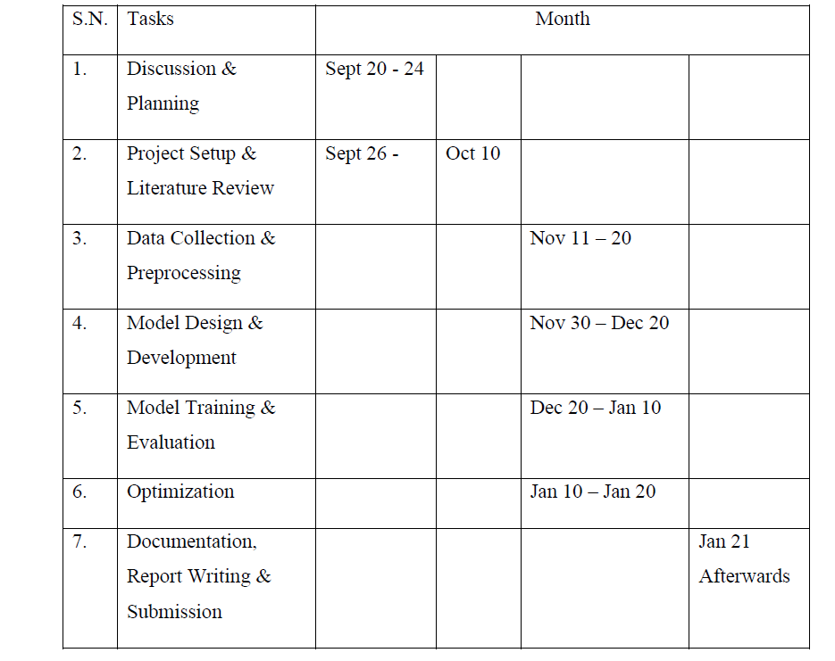
Gantt Chart

Slide 16
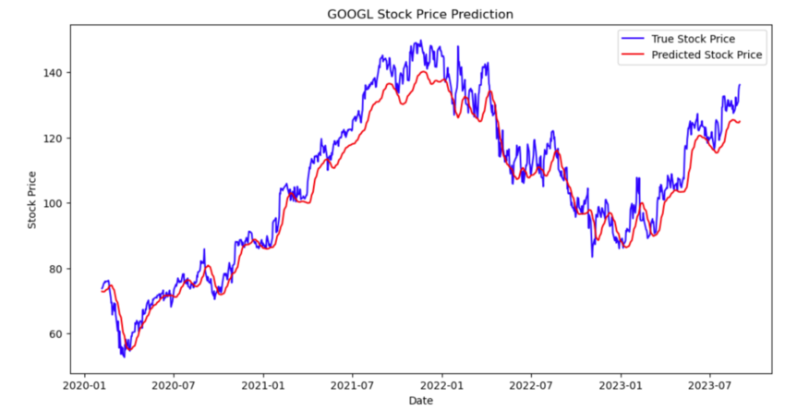
Expected Outcomes

Slide 17
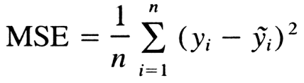
Evaluation/Testing
Mean Squared Error (MSE):
MSE measures the average of the squared differences between the predicted and actual values.
Goal: Minimize the MSE to improve the accuracy of predictions.
Interpretation: Lower MSE indicates better model performance.

Slide 18
References
[1] Kumar et al., 2022a D. Kumar, P.K. Sarangi, R. Verma, A systematic review of
stock market prediction using machine learning and statistical techniques Mate.
Today Proc, 49 (8) (2022), pp. 3187-3191,
https://doi.org/10.1016/j.matpr.2020.11.399
[2] Computational Intelligence and Financial Markets: A Survey and Future
Directions Rodolfo C. Cavalcante,Rodrigo C. Brasileiro,Victor L.F. Souza,Jarley P.
Nobrega,Adriano L.I. Oliveira
https://doi.org/10.1016/j.eswa.2016.02.006
[3] Nti et al., 2020 I.K. Nti, A.F. Adekoya, B.A. Weyori, A systematic review of
fundamental and technical analysis of stock market predictions ARTIFICIAL
INTELLIGENCE REVIEW, 53 (4) (2020), pp. 3007-3057,
https://doi.org/10.1007/s10462-019-09754-z
[4] Mondal, Prapanna & Shit, Labani & Goswami, Saptarsi. (2014). Study of Effectiveness of
Time Series Modeling (Arima) in Forecasting Stock Prices. International Journal of Computer Science, Engineering and Applications. 4. 13-29.
http://dx.doi.org/10.5121/ijcsea.2014.4202
[5] Siami Namini, Sima & Siami Namin, Akbar. (2018). Forecasting Economics and
Financial Time Series: ARIMA vs. LSTM.
https://doi.org/10.1109/BigData47090.2019.9005997

Slide 19
THANK YOU…

